Slide 1
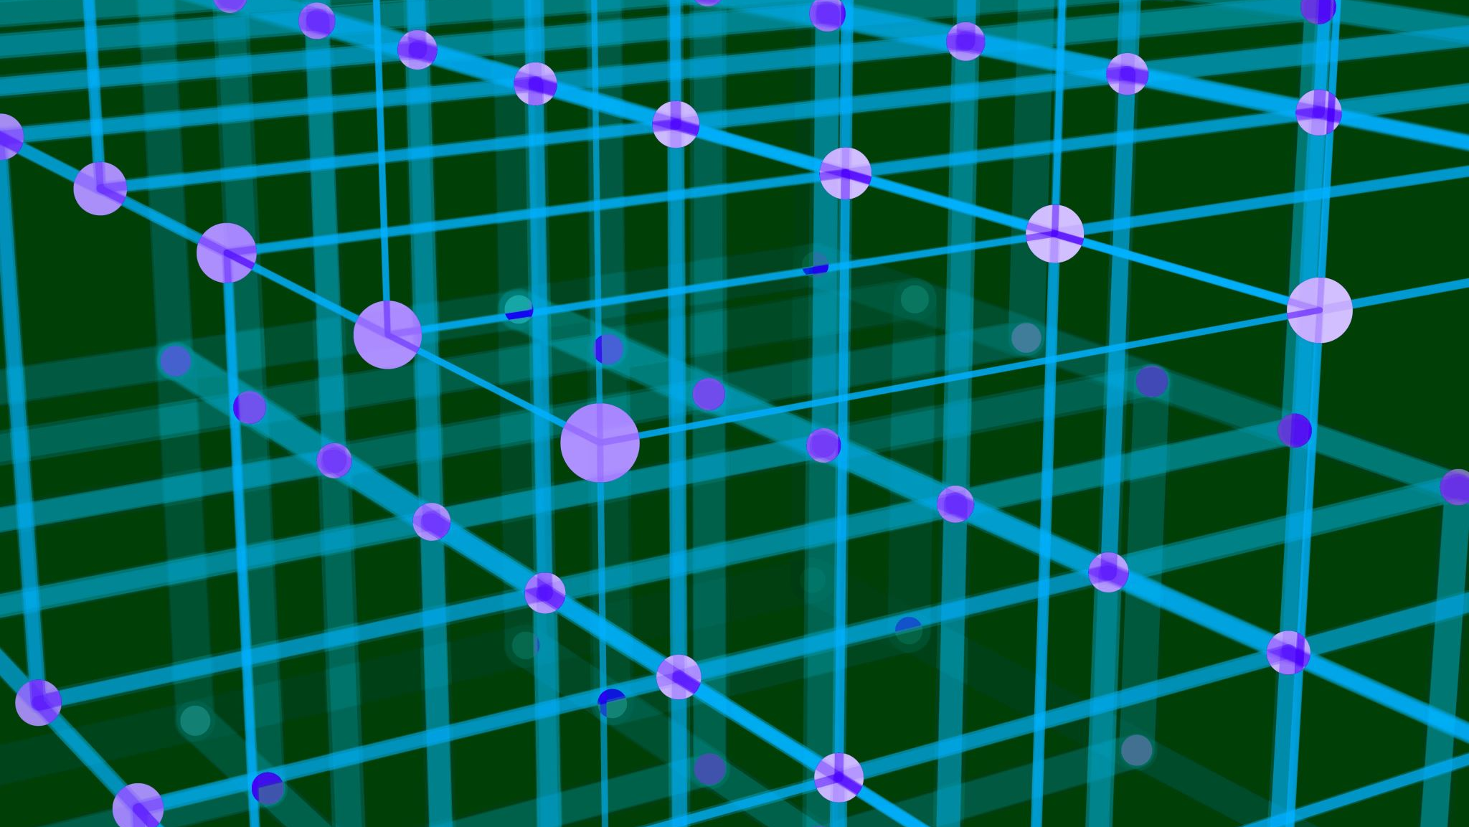

Generative AI
Gyanig Kumar
Research Assistant
Notes:
Sources: https://towardsdatascience.com/understanding-generative-adversarial-networks-gans-cd6e4651a29
https://developers.google.com/machine-learning/gan
https://developers.arcgis.com/python/guide/how-cyclegan-works/

Slide 2
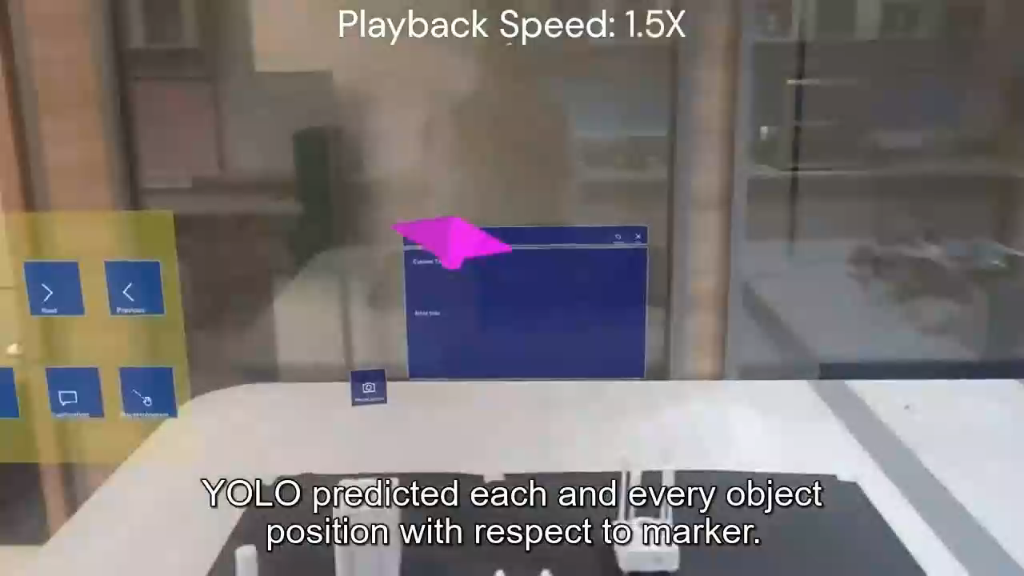
Use-Case Example in a Typical Computer Vision Domain – Object Detection in Advanced Manufacturing Setup

Slide 3
Part I Introduction to GAN

Slide 4
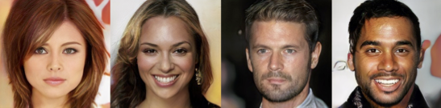
Introduction
Generative adversarial networks (GANs) or Generative AI are an exciting recent innovation in machine learning.
GANs are generative models:
Create new data instances that resemble your training data.
Achieve this level of realism by pairing a generator and with a discriminator
Fig. Images generated by a GAN (Source: NVIDIA)
Notes:
For example, GANs can create images that look like photographs of human faces, even though the faces don't belong to any real person.
Generator which learns to produce the target output
Discriminator tries to keep from being fooled.

Slide 5
Background: What is Generative Model?
Supervised vs. Unsupervised Learning
Examples of supervised learning problems include classification and regression, and examples of supervised learning algorithms include logistic regression and random forest.
Examples of unsupervised learning problems include clustering and generative modeling, and examples of unsupervised learning algorithms are K-means and Generative Adversarial Networks.
More formally, given a set of data instances X and a set of labels Y:
Generative models capture the joint probability p(X, Y), or just p(X) if there are no labels.
Discriminative models capture the conditional probability p(Y | X).
Generative Models Are Hard
Notes:
There is another paradigm of learning where the model is only given the input variables (X) and the problem does not have any output variables (y).
we are only given inputs, and the goal is to find “interesting patterns” in the data. […] This is a much less well-defined problem, since we are not told what kinds of patterns to look for, and there is no obvious error metric to use (unlike supervised learning, where we can compare our prediction of y for a given x to the observed value).
A generative model could generate new photos of animals that look like real animals, while a discriminative model could tell a dog from a cat. GANs are just one kind of generative model.
A generative model includes the distribution of the data itself, and tells you how likely a given example is.
A discriminative model ignores the question of whether a given instance is likely, and just tells you how likely a label is to apply to the instance.
Note that this is a very general definition. There are many kinds of generative model. GANs are just one kind of generative model.

Slide 6
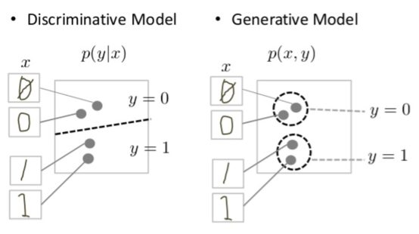
Discriminative model tries to tell the difference between handwritten 0's and 1's by drawing a line in the data space.
In contrast, the generative model tries to produce convincing 1's and 0's by generating digits that fall close to their real counterparts in the data space.
Notes:
In case of discriminative model, If it gets the line right, it can distinguish 0's from 1's without ever having to model exactly where the instances are placed in the data space on either side of the line.
In case of generative model, It has to model the distribution throughout the data space.

Slide 7
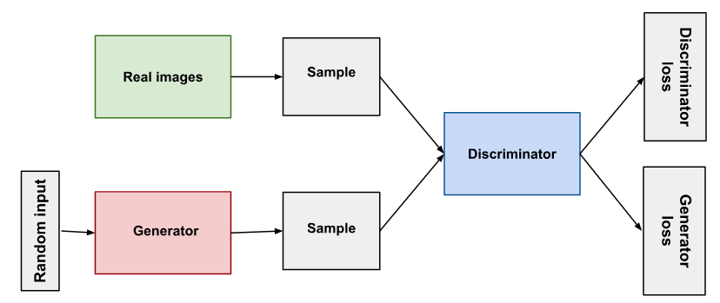
Overview of GAN Structure
Generator learns to generate plausible data. The generated instances become negative training examples for the discriminator.
Discriminator learns to distinguish the generator's fake data from real data. The discriminator penalizes the generator for producing implausible results.
Generator output is connected directly to the discriminator input.
Notes:
Through backpropagation, the discriminator's classification provides a signal that the generator uses to update its weights.

Slide 8
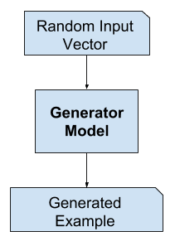
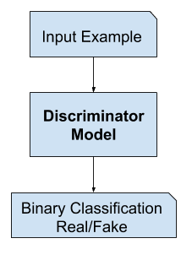
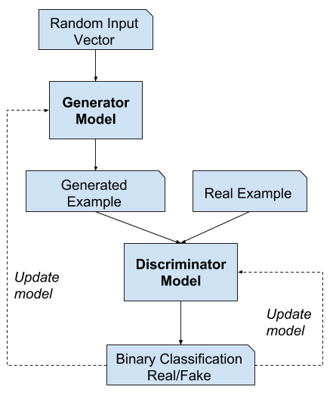
[training] drives the discriminator to attempt to learn to correctly classify samples as real or fake.
Simultaneously, the generator attempts to fool the classifier into believing its samples are real.
At convergence, the generator’s samples are indistinguishable from real data, and the discriminator outputs 1/2 everywhere.
The discriminator may then be discarded.

Slide 9
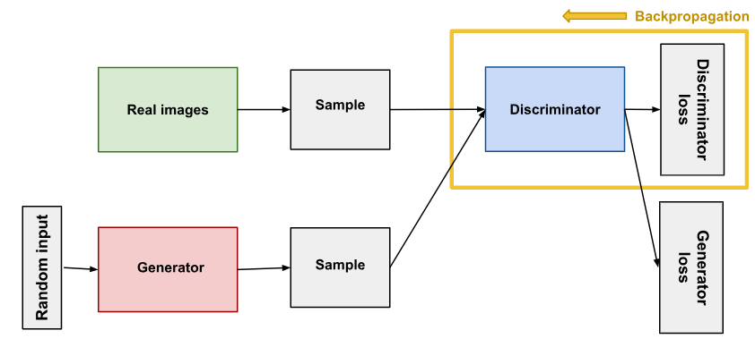
Discriminator
Discriminator's training data comes from two sources:
Real data instances, such as real pictures of people.
Fake data instances created by the generator.
During discriminator training:
The discriminator classifies both real data and fake data from the generator.
The discriminator loss penalizes the discriminator for misclassifying a real instance as fake or a fake instance as real.
The discriminator updates its weights through backpropagation from the discriminator loss through the discriminator network.
Discriminator can use any network architecture appropriate to the type of data it's classifying
Notes:
Real data: The discriminator uses these instances as positive examples during training.
Fake data: The discriminator uses these instances as negative examples during training.

Slide 10
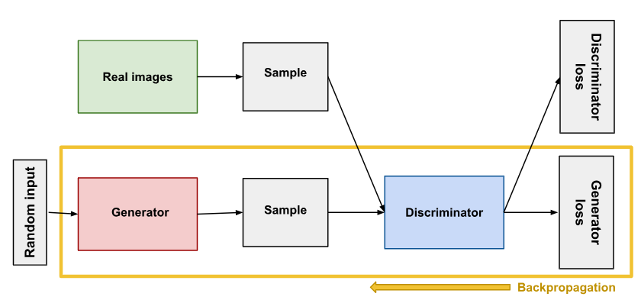
Generator
The portion of the GAN that trains the generator includes:
random input
generator network, which transforms the random input into a data instance
discriminator network, which classifies the generated data
discriminator output
generator loss, which penalizes the generator for failing to fool the discriminator
Random input is:
In its most basic form, a GAN takes random noise as its input
Choose something that's easy to sample from, like a uniform distribution
Notes:
The generator part of a GAN learns to create fake data by incorporating feedback from the discriminator. It learns to make the discriminator classify its output as real.
In its most basic form, a GAN takes random noise as its input. The generator then transforms this noise into a meaningful output. By introducing noise, we can get the GAN to produce a wide variety of data, sampling from different places in the target distribution.
Experiments suggest that the distribution of the noise doesn't matter much, so we can choose something that's easy to sample from, like a uniform distribution. For convenience the space from which the noise is sampled is usually of smaller dimension than the dimensionality of the output space.

Slide 11
Generating Random Variables
Computers are fundamentally deterministic
it is possible to define algorithms that generate sequences of numbers whose properties are very close to the properties of theoretical random numbers sequences
Methods: inverse transform method, rejection sampling, Metropolis-Hasting algorithm and others
Notes:
Computers are fundamentally deterministic. So, it is, in theory, impossible to generate numbers that are really random (even if we could say that the question “what really is randomness ?” is a difficult one). However, it is possible to define algorithms that generate sequences of numbers whose properties are very close to the properties of theoretical random numbers sequences. In particular, a computer is able, using a pseudorandom number generator, to generate a sequence of numbers that approximatively follows a uniform random distribution between 0 and 1. The uniform case is a very simple one upon which more complex random variables can be built in different ways.

Slide 12
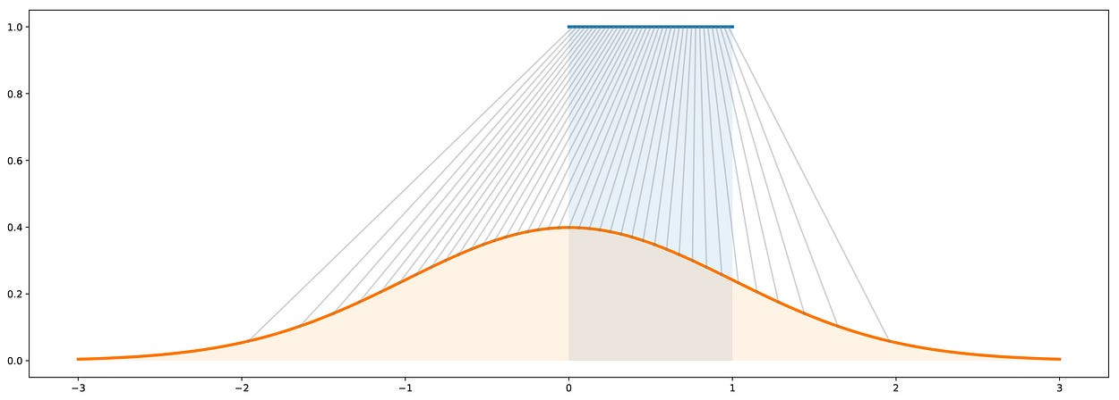
Generating Random Variables
inverse transform method
way to generate a random variable that follows a given distribution by making a uniform random variable goes through a well designed “transform function” (inverse CDF)
Illustration of the inverse transform method. In blue: the uniform distribution over [0,1]. In orange: the standard gaussian distribution. In grey: the mapping from the uniform to the gaussian distribution (inverse CDF).
Notes:
Original GAN :
A maximum likelihood estimator is an extremum estimator obtained by maximizing, as a function of θ, the objective function ℓ^(�;�). If the data are independent and identically distributed,

Slide 13
Use the Discriminator to train Generator
Sample random noise.
Produce generator output from sampled random noise.
Get discriminator "Real" or "Fake" classification for generator output.
Calculate loss from discriminator classification.
Backpropagate through both the discriminator and generator to obtain gradients.
Use gradients to change only the generator weights.
Notes:
In our GAN, however, the generator is not directly connected to the loss that we're trying to affect. The generator feeds into the discriminator net, and the discriminator produces the output we're trying to affect. The generator loss penalizes the generator for producing a sample that the discriminator network classifies as fake.
Backpropagation adjusts each weight in the right direction by calculating the weight's impact on the output — how the output would change if you changed the weight. But the impact of a generator weight depends on the impact of the discriminator weights it feeds into.
In the next slide we'll see how to juggle the training of both the generator and the discriminator.

Slide 14
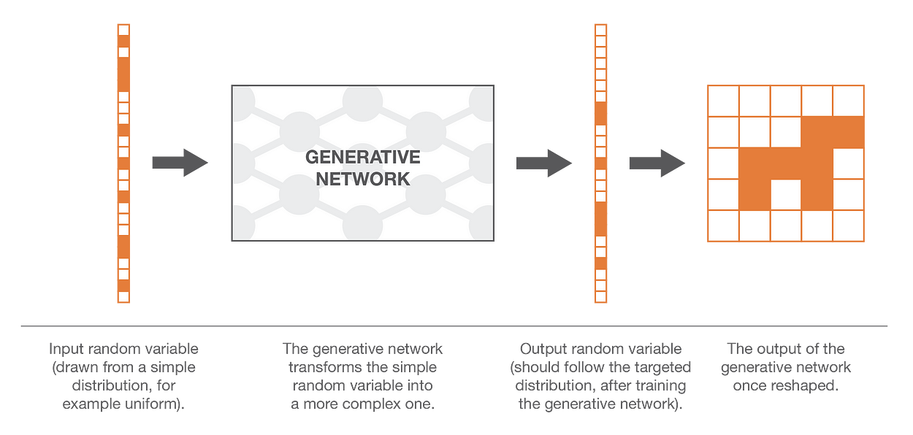
Generative model approximation
finding the transform function is not as straightforward
complex function naturally implies neural network modelling
model the transform function by a neural network
input : simple N dimensional uniform random variable
output : another N dimensional random variable that should follow complex probability distribution corresponding to desired output
Notes:
as we know pretty well how to generate N uncorrelated uniform random variables, we could make use of the transform method.
To do so, we need to express our N dimensional random variable as the result of a very complex function applied to a simple N dimensional random variable!
However, finding the transform function is not as straightforward as just taking the closed-form inverse of the Cumulative Distribution Function
Computers are fundamentally deterministic. So, it is, in theory, impossible to generate numbers that are really random (even if we could say that the question “what really is randomness ?” is a difficult one). However, it is possible to define algorithms that generate sequences of numbers whose properties are very close to the properties of theoretical random numbers sequences. In particular, a computer is able, using a pseudorandom number generator, to generate a sequence of numbers that approximatively follows a uniform random distribution between 0 and 1. The uniform case is a very simple one upon which more complex random variables can be built in different ways.

Slide 15
Training GAN
GANs must juggle two different kinds of training (generator and discriminator)
GAN convergence is hard to identify
Alternate Training
The discriminator trains for one or more epochs
The generator trains for one or more epochs
Repeat steps 1 and 2 to continue to train the generator and discriminator networks
Convergence
As the generator improves with training, the discriminator performance gets worse
This progression poses a problem
Discriminator feedback gets less meaningful over time
Notes:
We keep the generator constant during the discriminator training phase. As discriminator training tries to figure out how to distinguish real data from fake, it has to learn how to recognize the generator's flaws. That's a different problem for a thoroughly trained generator than it is for an untrained generator that produces random output.
Similarly, we keep the discriminator constant during the generator training phase. Otherwise, the generator would be trying to hit a moving target and might never converge.
Convergence
As the generator improves with training, the discriminator performance gets worse because the discriminator can't easily tell the difference between real and fake. If the generator succeeds perfectly, then the discriminator has a 50% accuracy. In effect, the discriminator flips a coin to make its prediction.
This progression poses a problem for convergence of the GAN as a whole: the discriminator feedback gets less meaningful over time. If the GAN continues training past the point when the discriminator is giving completely random feedback, then the generator starts to train on junk feedback, and its own quality may collapse.

Slide 16

Loss Functions
minimax loss
$$E_{x}[log⁡(D(x))]+E_{z}[log⁡(1−D(G(z))]$$
$D(x)$ : discriminator's estimate of the probability that real data instance x is real
$E_{x}$ : expected value over all real data instances
$G(z)$: generator's output when given noise z
$D(G(z))$: discriminator's estimate of the probability that a fake instance is real
$E_{z}$: expected value over all generated fake instances G(z)
Generator can't directly affect the log(D(x))
minimax loss function can cause the GAN to get stuck in the early stages
modify the generator loss so that the generator tries to maximize log D(G(z))
Cont..
Notes:
GANs try to replicate a probability distribution. They should therefore use loss functions that reflect the distance between the distribution of the data generated by the GAN and the distribution of the real data.
The formula derives from the cross-entropy between the real and generated distributions.
In the loss schemes we'll look at here, the generator and discriminator losses derive from a single measure of distance between probability distributions. In both of these schemes, however, the generator can only affect one term in the distance measure: the term that reflects the distribution of the fake data. So during generator training we drop the other term, which reflects the distribution of the real data.

Slide 17

Loss Functions
Wasserstein loss (WGAN discriminator is actually called a "critic" instead of a "discriminator")
$$Critic Loss: D(x) − D(G(z))$$
discriminator tries to maximize the difference between its output on real instances and its output on fake instances.
Generator Loss: D(G(z))
generator tries to maximize the discriminator's output for its fake instances.
In these functions:
D(x) is the critic's output for a real instance.
G(z) is the generator's output when given noise z.
D(G(z)) is the critic's output for a fake instance.
The output of critic D does not have to be between 1 and 0.
Notes:
This loss function depends on a modification of the GAN scheme
discriminator does not actually classify instances. For each instance it outputs a number. This number does not have to be less than one or greater than 0.
Discriminator training just tries to make the output bigger for real instances than for fake instances.
Critic loss: The discriminator tries to maximize this function. In other words, it tries to maximize the difference between its output on real instances and its output on fake instances.

Slide 18
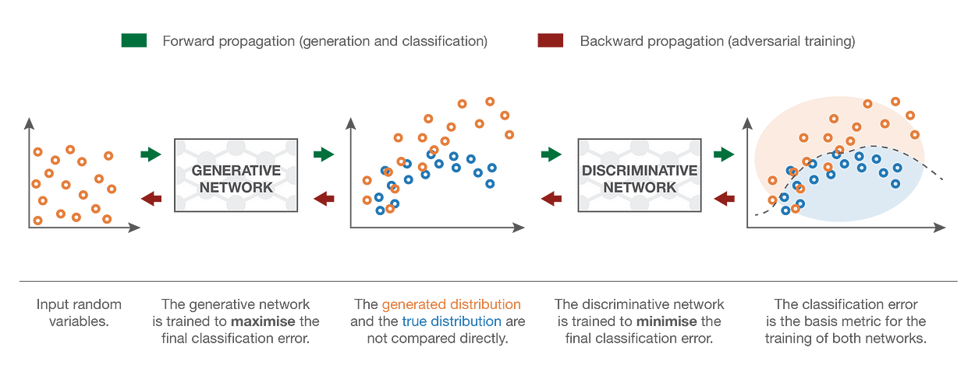
The approximation: GAN
Two networks can then be trained jointly (at the same time) with opposite goals:
the goal of the generator is to fool the discriminator, so the generative neural network is trained to maximise the final classification error (between true and generated data)
the goal of the discriminator is to detect fake generated data, so the discriminative neural network is trained to minimise the final classification error
These opposite goals and the implied notion of adversarial training
From a game theory point of view, we can think of this setting as a minimax two-players game
Notes:
These opposite goals and the implied notion of adversarial training of the two networks explains the name of “adversarial networks”: both networks try to beat each other and, doing so, they are both becoming better and better. The competition between them makes these two networks “progress” with respect to their respective goals. From a game theory point of view, we can think of this setting as a minimax two-players game where the equilibrium state corresponds to the situation where the generator produces data from the exact targeted distribution and where the discriminator predicts “true” or “generated” with probability 1/2 for any point it receives.

Slide 19
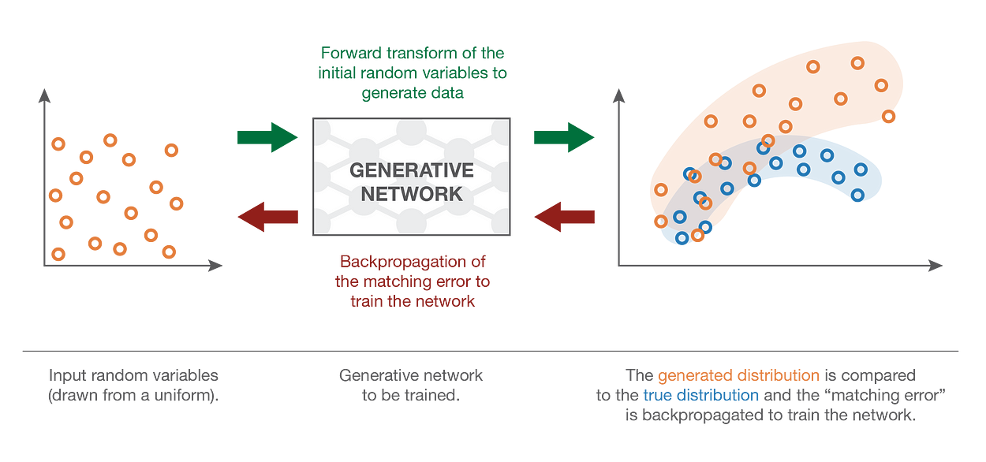
Direct method
Comparing two probability distributions based on samples
Maximum Mean Discrepancy (MMD) approach
defines a distance between two probability distributions
GMN optimize the network by
generate some uniform inputs
make these inputs go through the network and collect the generated outputs
compare the true distribution and the generated one based on the available samples
use backpropagation to make one step of gradient descent to lower the distance (for example MMD) between true and generated distributions

Slide 20
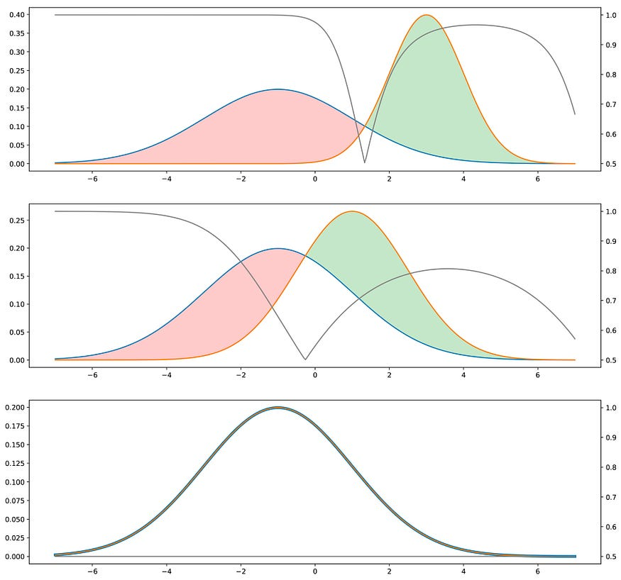
The “indirect” training method
downstream task of GANs is a discrimination task between true and generated samples [Discriminator]
If the two distributions are far apart, the discriminator will be able to classify easily
Intuition for the adversarial method. The blue distribution is the true one, the orange is the generated one. In grey, with corresponding y-axis on the right, we displayed the probability to be true for the discriminator if it chooses the class with the higher density in each point (assuming “true” and “generated” data are in equal proportions). The closer the two distributions are, the more often the discriminator is wrong. When training, the goal is to “move the green area” (generated distribution is too high) towards the red area (generated distribution is too low).
Notes:
At this point, it seems legit to wonder whether this indirect method is really a good idea. Indeed, it seems to be more complicated (we have to optimise the generator based on a downstream task instead of directly based on the distributions) and it requires a discriminator that we consider here as a given oracle but that is, in reality, neither known nor perfect. For the first point, the difficulty of directly comparing two probability distributions based on samples counterbalances the apparent higher complexity of indirect method. For the second point, it is obvious that the discriminator is not known. However, it can be learned!

Slide 21
Type of GANs
Progressive GAN (Progressive Growing of GANs for Improved Quality, Stability, and Variation)
generator's first layers produce very low-resolution images, and subsequent layers add details
Training is quicker
Produce higher resolution images
Conditional GAN (Conditional Generative Adversarial Nets)
train on a labeled data set and let you specify the label for each generated instance
a conditional MNIST GAN would let you specify which digit the GAN should generate
Instead of modeling the joint probability P(X, Y), conditional GANs model the conditional probability P(X | Y)
Notes:
Conditional GANs are similar to standard GANs except they allow the model to conditionally generate samples based on additional information. For example, if we want to generate a cat face given a dog picture, we could use a conditional GAN.

Slide 22
Type of GANs
Image-to-Image Translation (Image-to-Image Translation with Conditional Adversarial Networks)
take an image as input and map it to a generated output image with different properties
take sketches of objects and turn them into photorealistic images of that object
CycleGAN (Unpaired Image-to-Image Translation using Cycle-Consistent Adversarial Networks)
transform images from one set into images that could plausibly belong to another set
training data for the CycleGAN is simply two sets of images
requires no labels or pairwise correspondences between images

Slide 23
Type of GANs
Text-to-Image Synthesis (StackGAN: Text to Photo-realistic Image Synthesis with Stacked Generative Adversarial Networks)
take text as input and produce images that are plausible and described by the text
take sketches of objects and turn them into photorealistic images of that object
Super-resolution (Photo-Realistic Single Image Super-Resolution Using a Generative Adversarial Network)
increase the resolution of images, adding detail where necessary to fill in blurry areas

Slide 24
Part II Synthetic Data

Slide 25
Use-Case Example in a Typical Computer Vision Domain – Object Detection in Advanced Manufacturing Setup

Slide 26
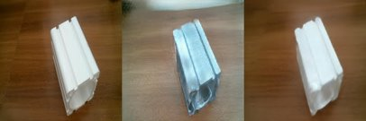
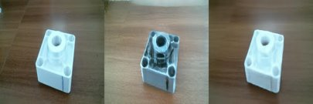
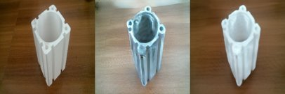
Generation of Synthetic Data
The Use-Cases of GANs
Virtual Environments
Style Transfer
Object Detection
3D Object Generation
Data Imbalance Correction
Image Augmentation

Slide 27
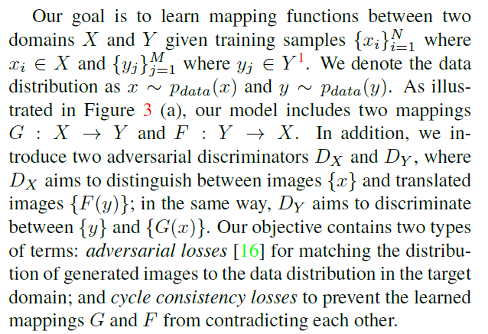
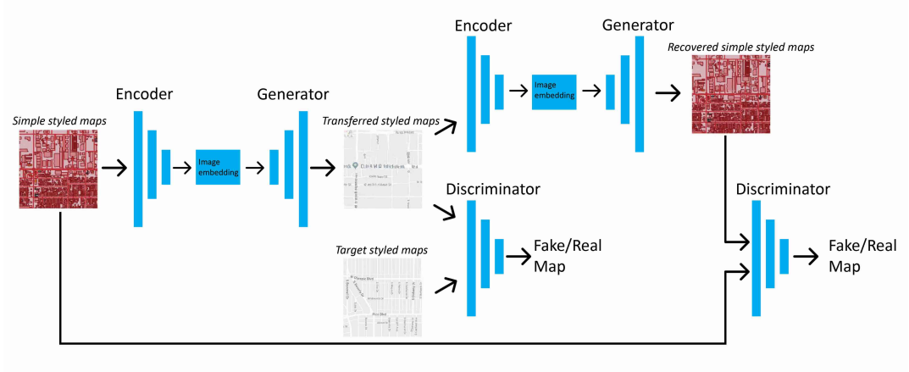


CycleGAN
X
G
F
X
Y
$$D_{Y}$$
$$D_{X}$$
Figure. Overview of CycleGAN architecture: Translating from satellite image to map routes domain

Slide 28
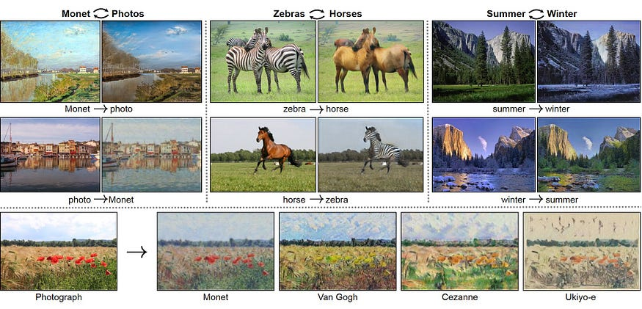
Examples

Slide 29
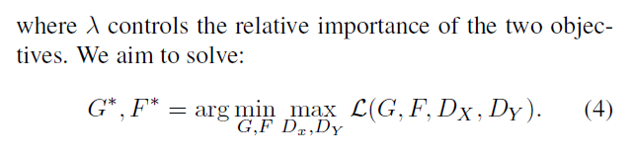
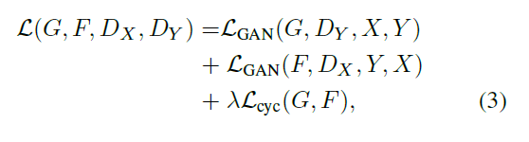
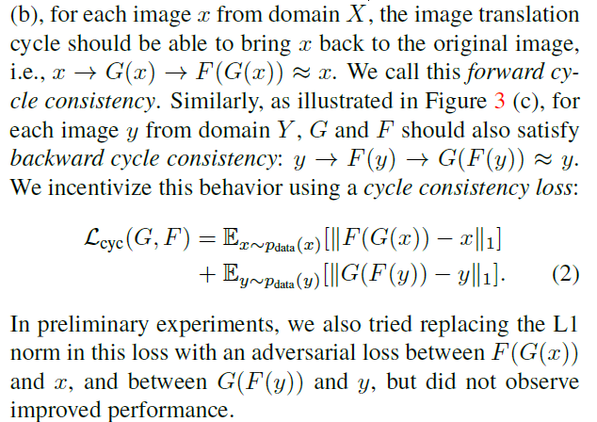
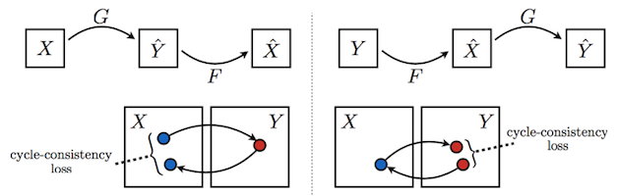
Cycle Consistency Loss
Objective
Notes:
There are two probability spaces , corresponding to the two domains needed for translations fore-and-back.
There are 4 players in 2 teams:
where lambda is a positive adjustable parameter, LGan is the GAN game objective, and Lcycle is the cycle consistency loss:
Cycle consitency loss :
This kind of loss uses the intuition that if we translate a sample from Domain X to Y using mapping function G and then map it back to X using function F, how close are we from arriving at the original sample. Similarly, it calculates the loss incurred by translating a sample from Y to X and then back again to Y. This cyclic loss should be minimised.
Role of G: G is trying to translate X into outputs, which are fed through Dy to check whether they are real or fake according to Domain Y
Role of F : F is trying to translate Y into outputs, which are fed through Dx to check if they are indistinguishable from Domain X
Adversarial training can, in theory, learn mappings G and F that produce outputs identically distributed as target domains Y and X respectively (strictly speaking, this requires G and F to be stochastic functions) [15]. However, with large enough capacity, a network can map the same set of input images to any random permutation of images in the target domain, where any of the learned mappings can induce an output distribution that matches the target distribution. Thus, adversarial losses alone cannot guarantee that the learned function can map an individual input xi to a desired output y functions should be cycle-consistent:i. To further reduce the space of possible mapping functions, we argue that the learned mapping functions should be cycle-consistent:

Slide 30
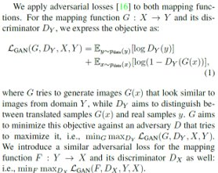
Adversarial Loss

Slide 31
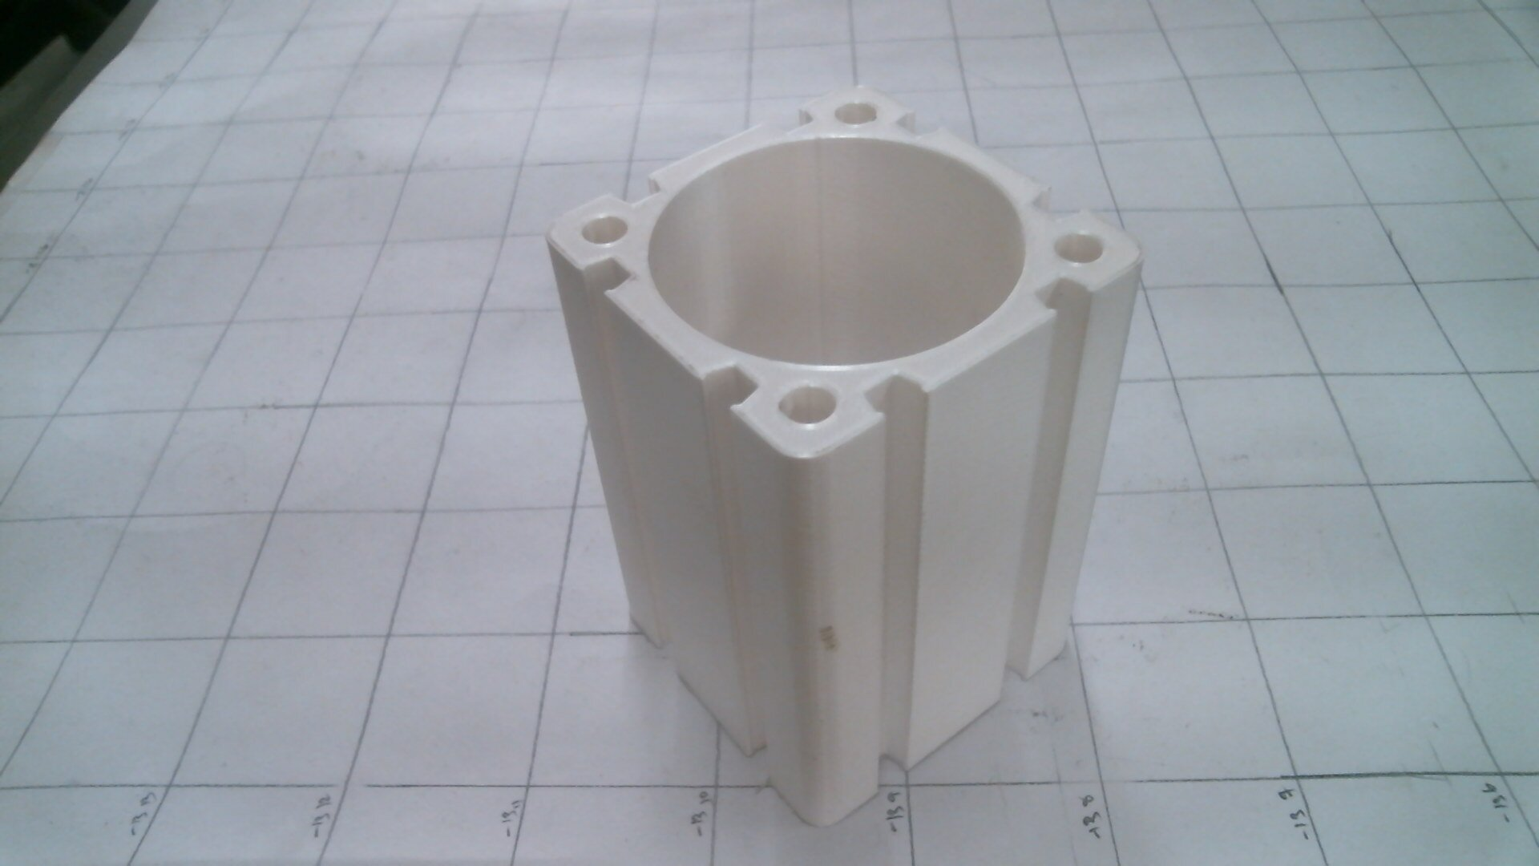
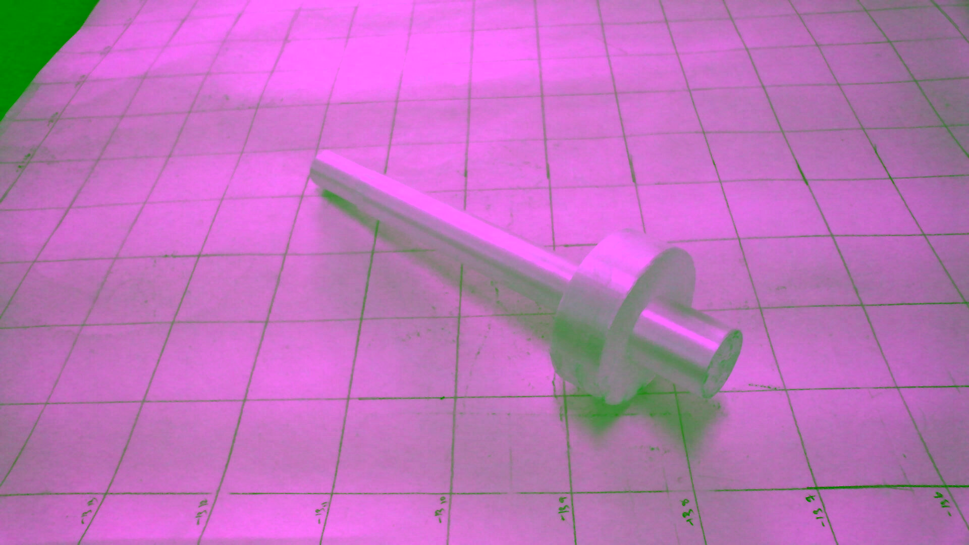
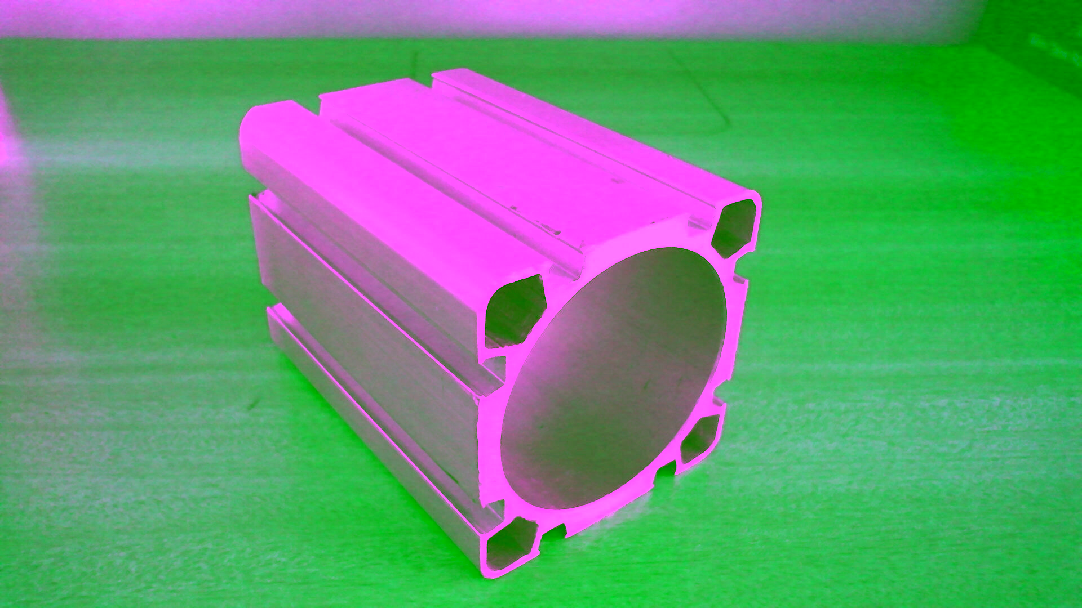
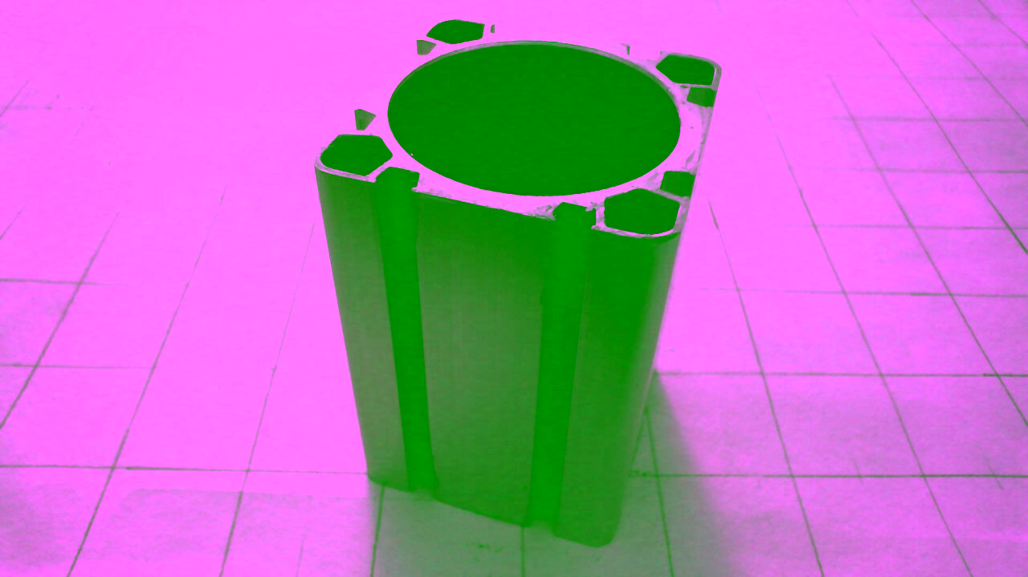
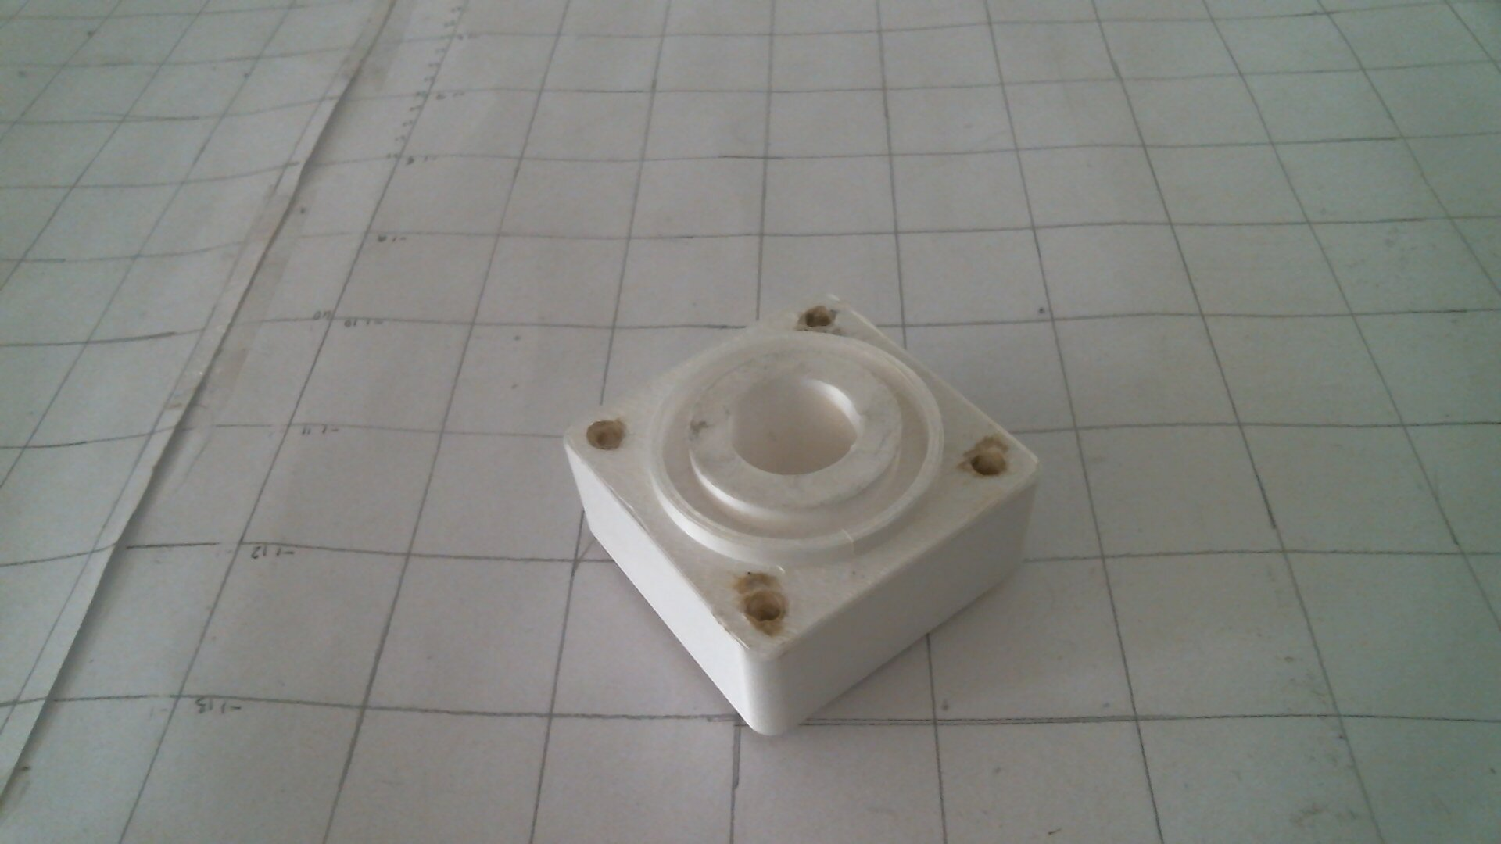
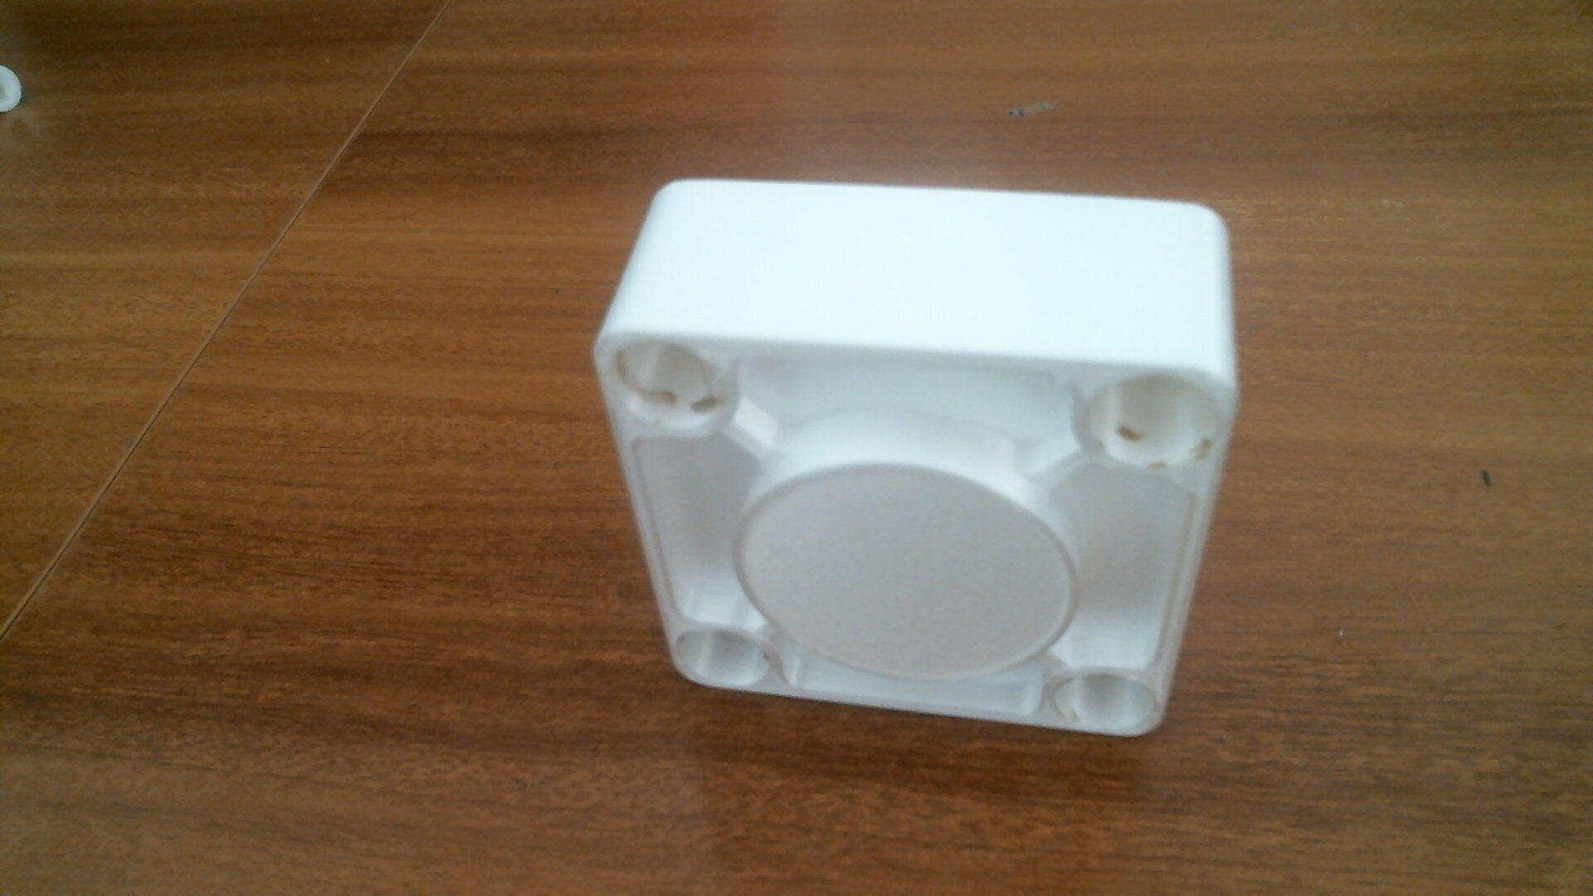
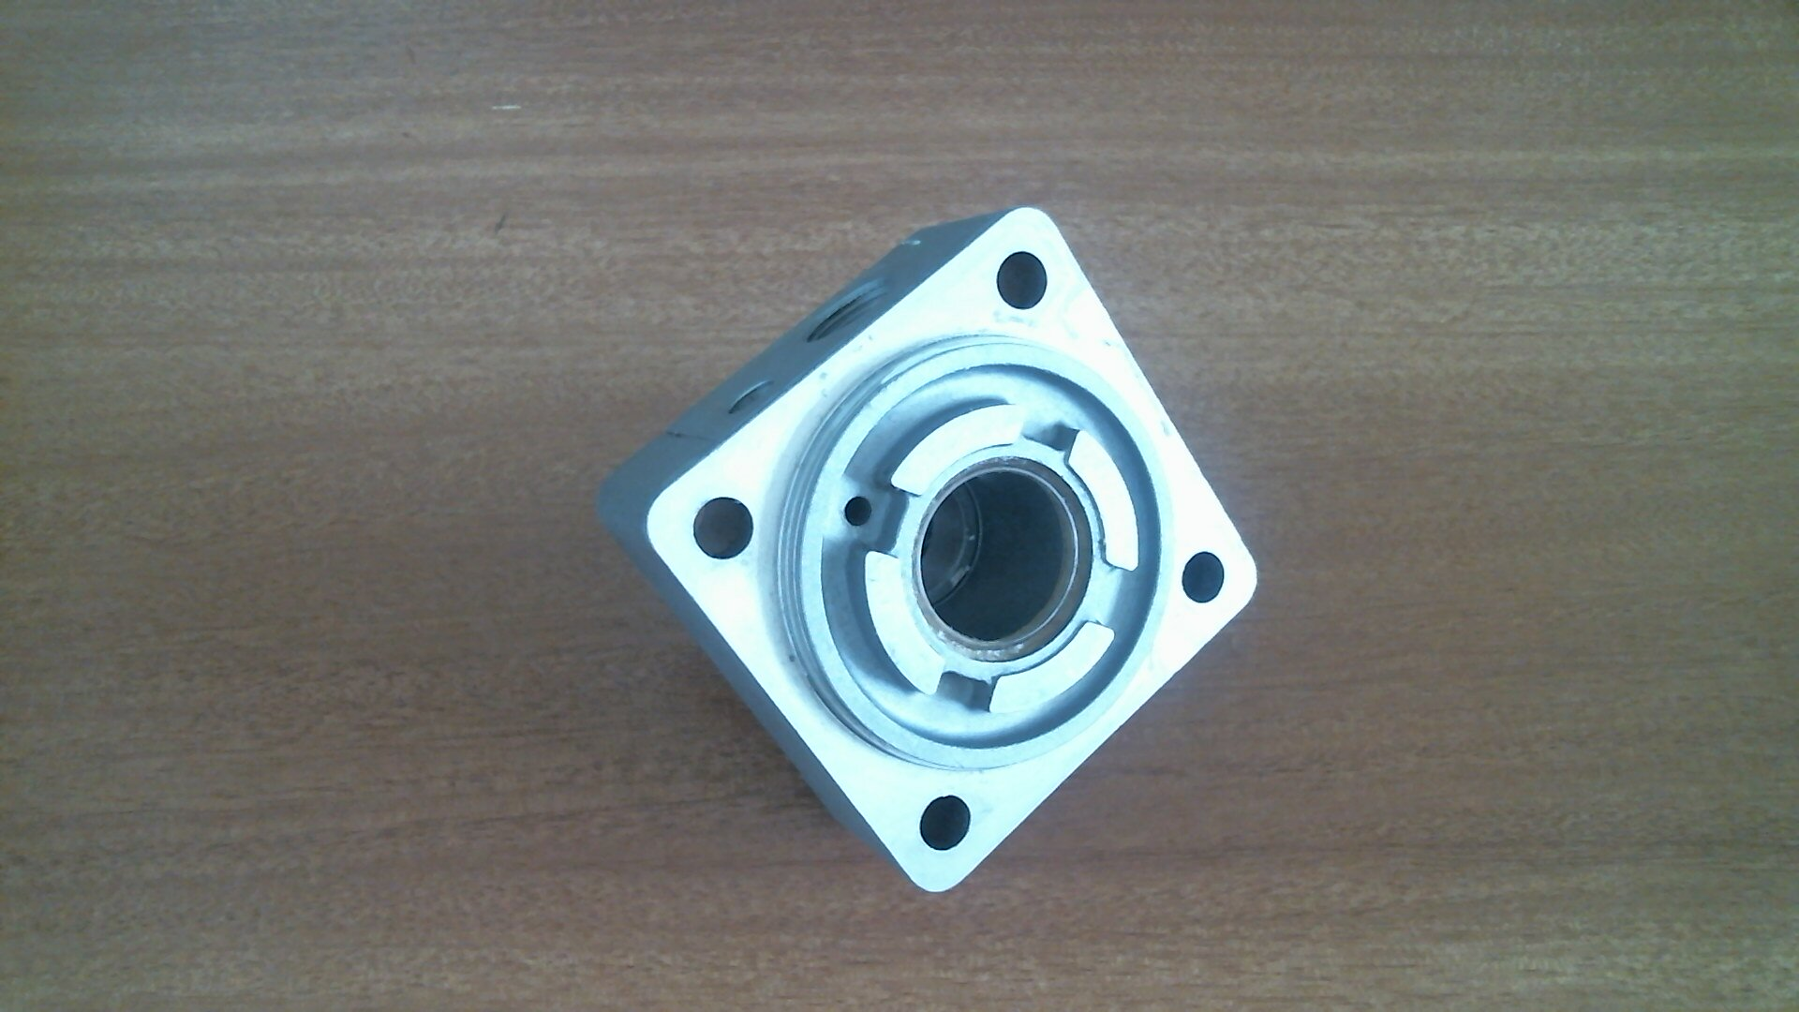
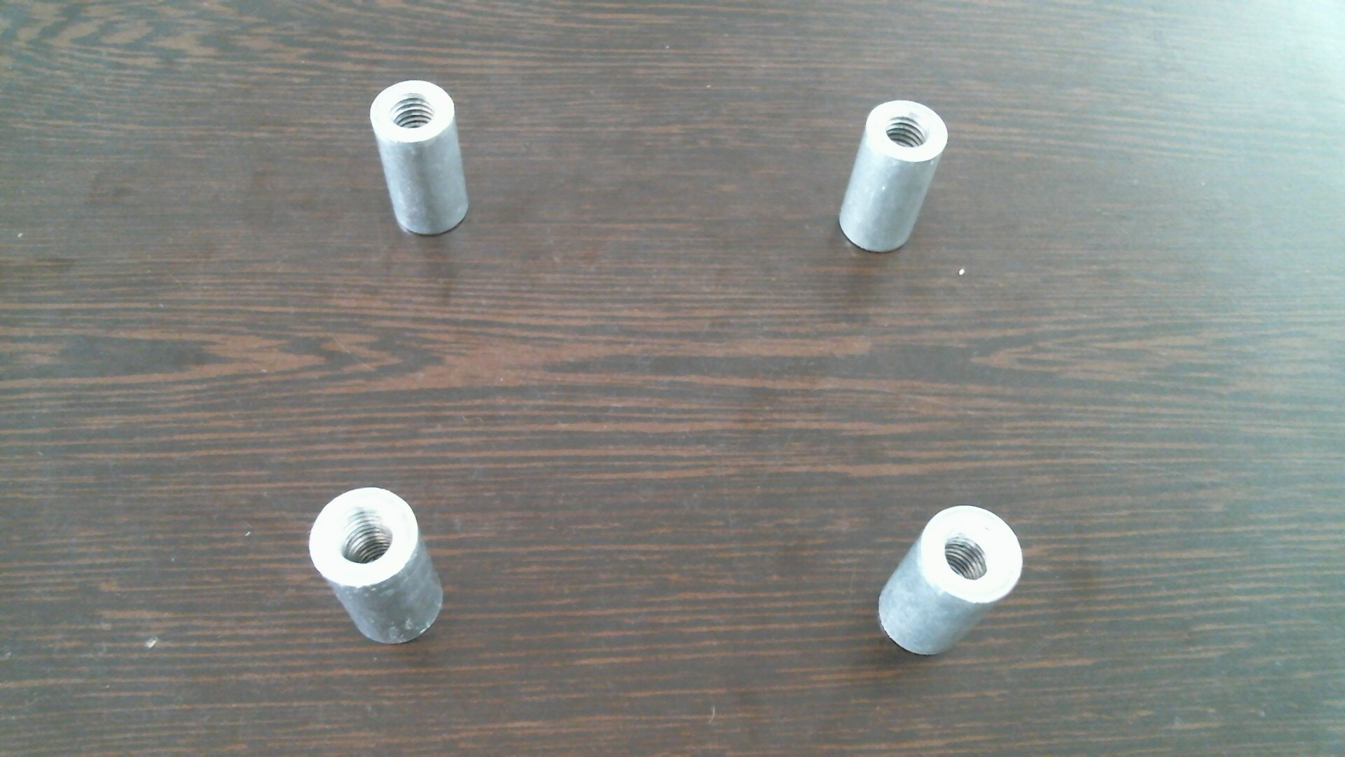
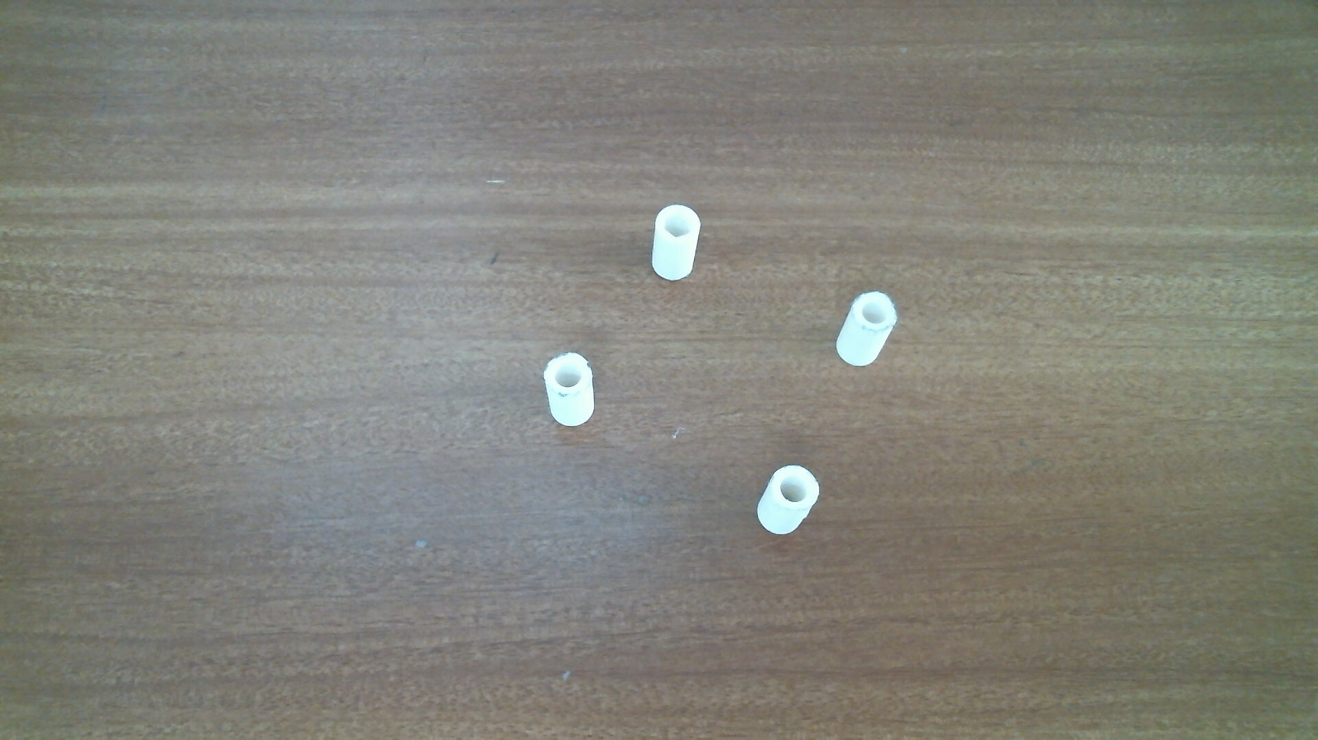
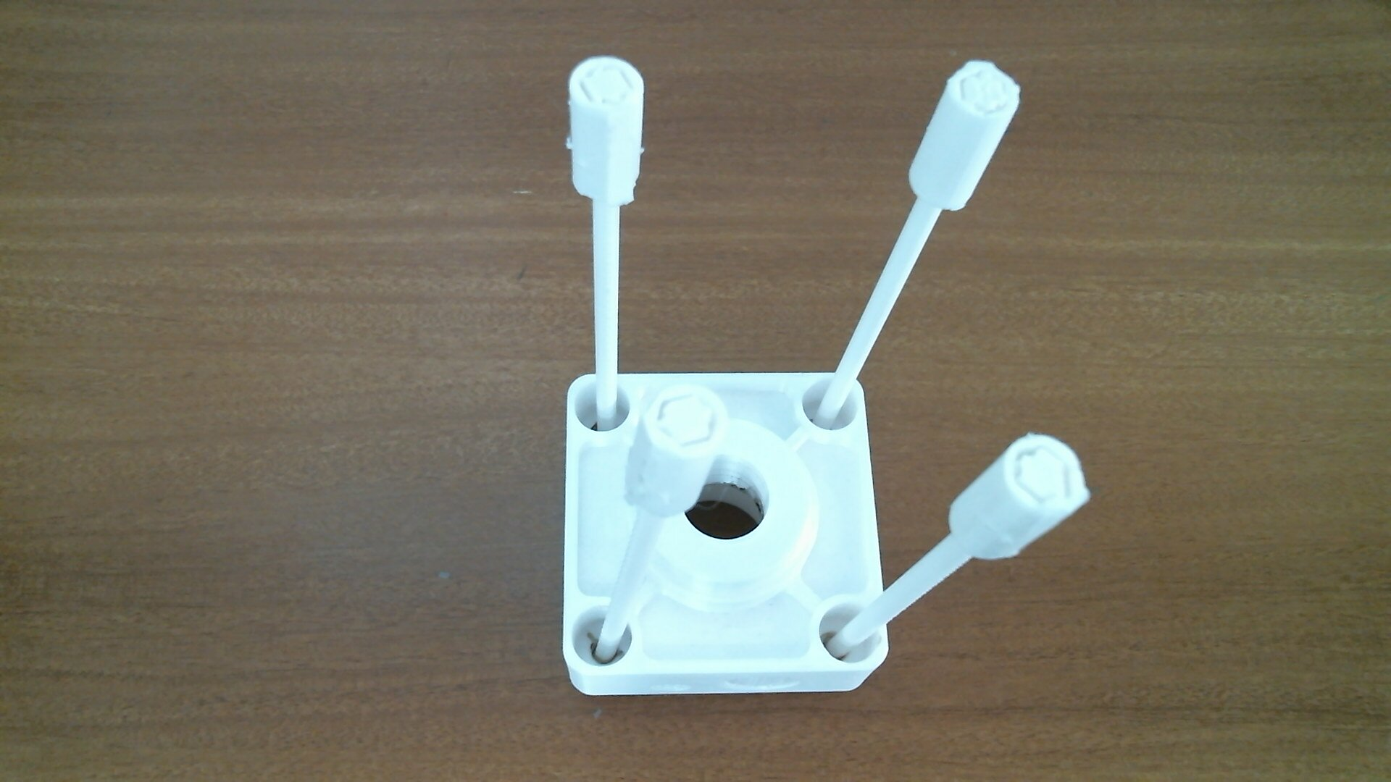
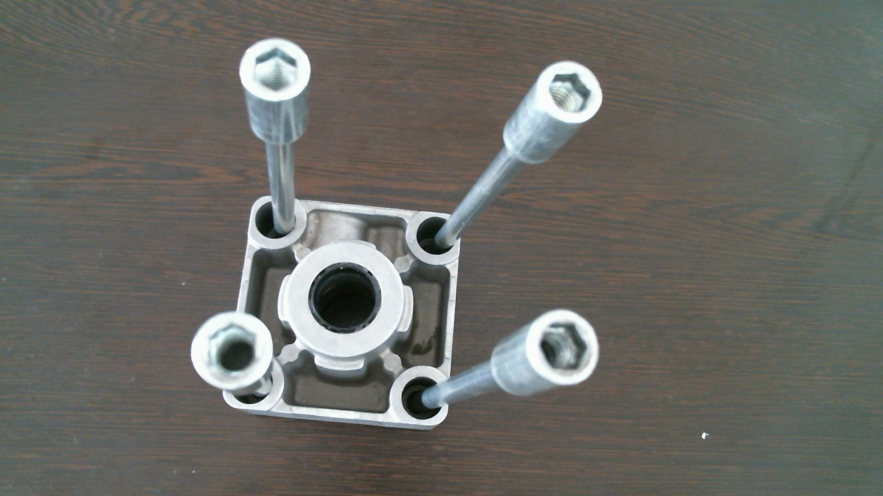
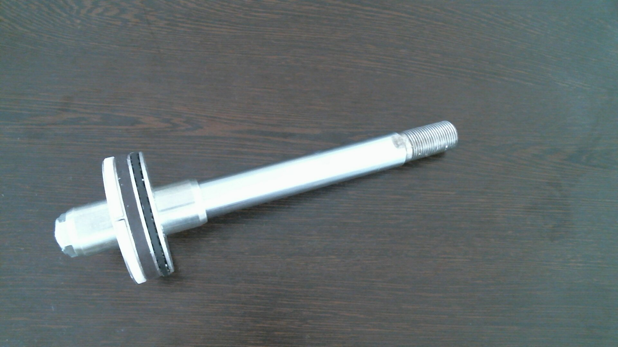
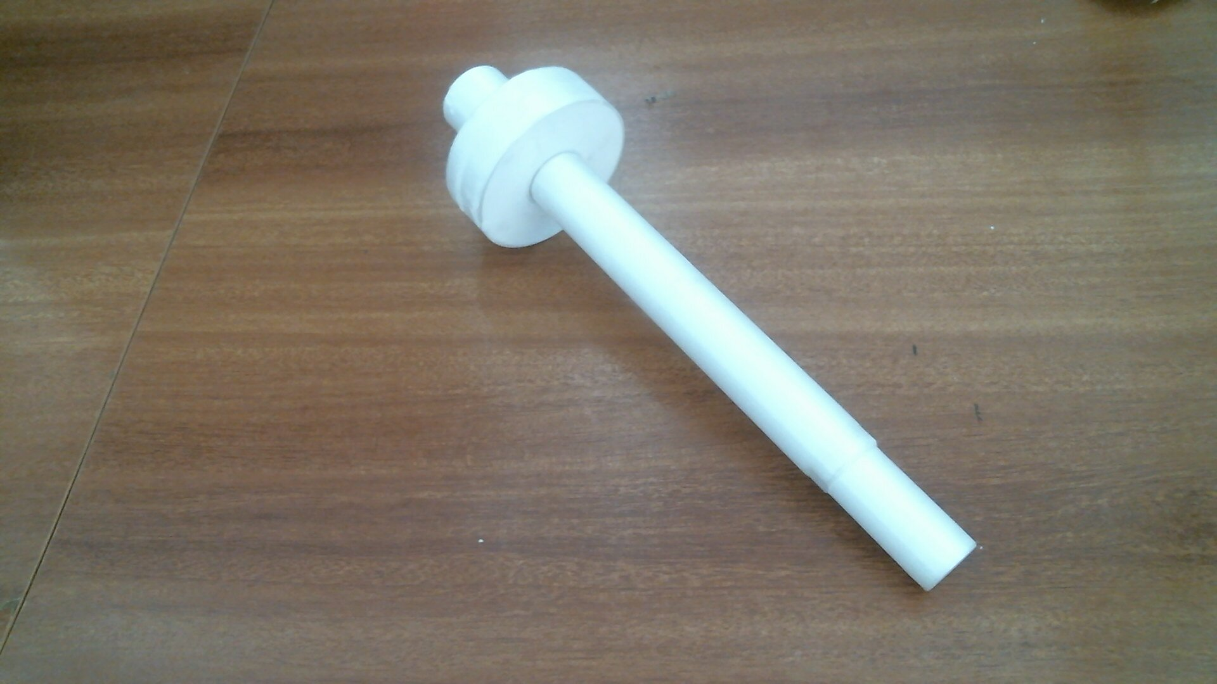
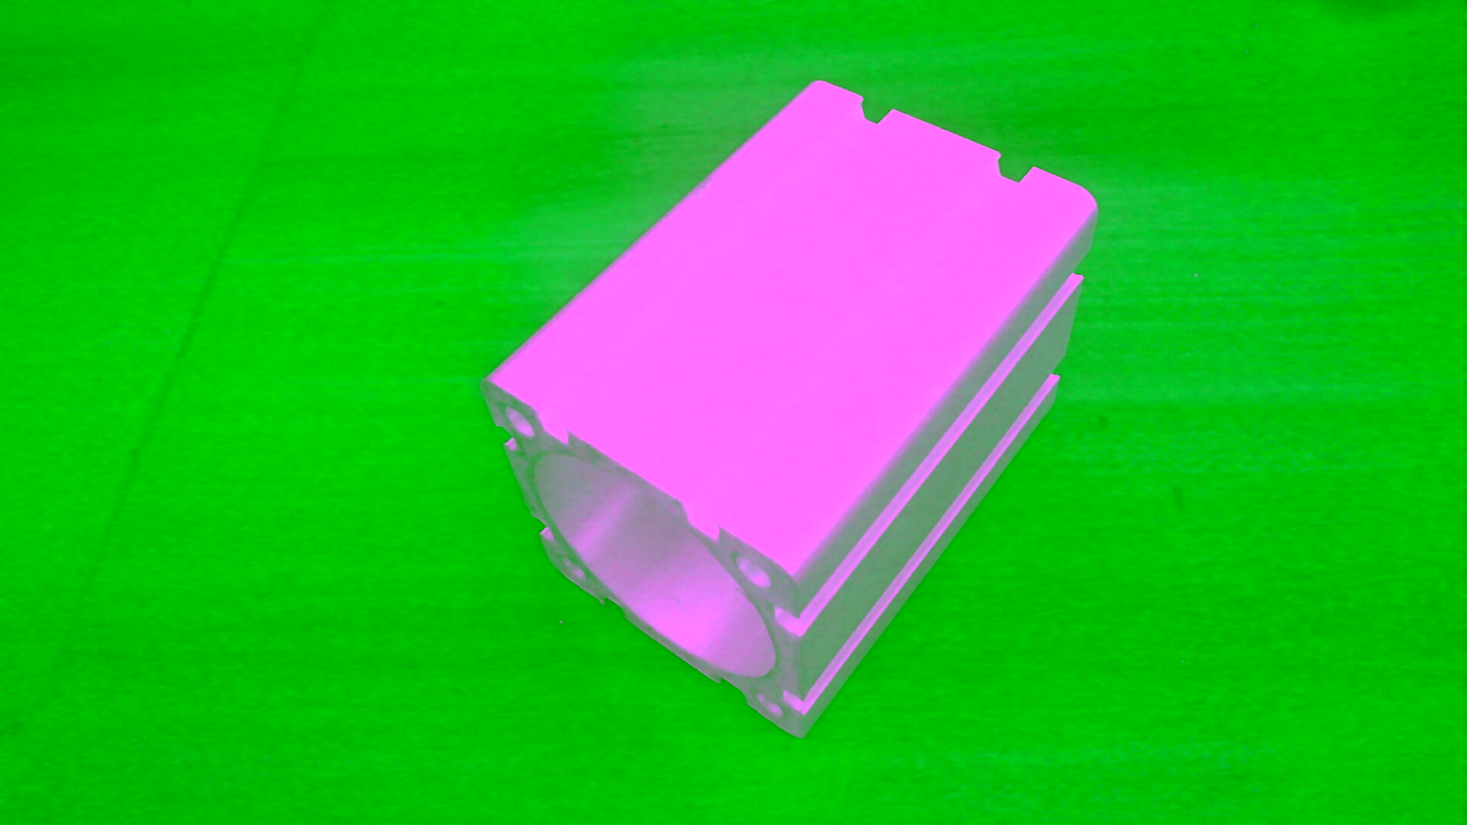
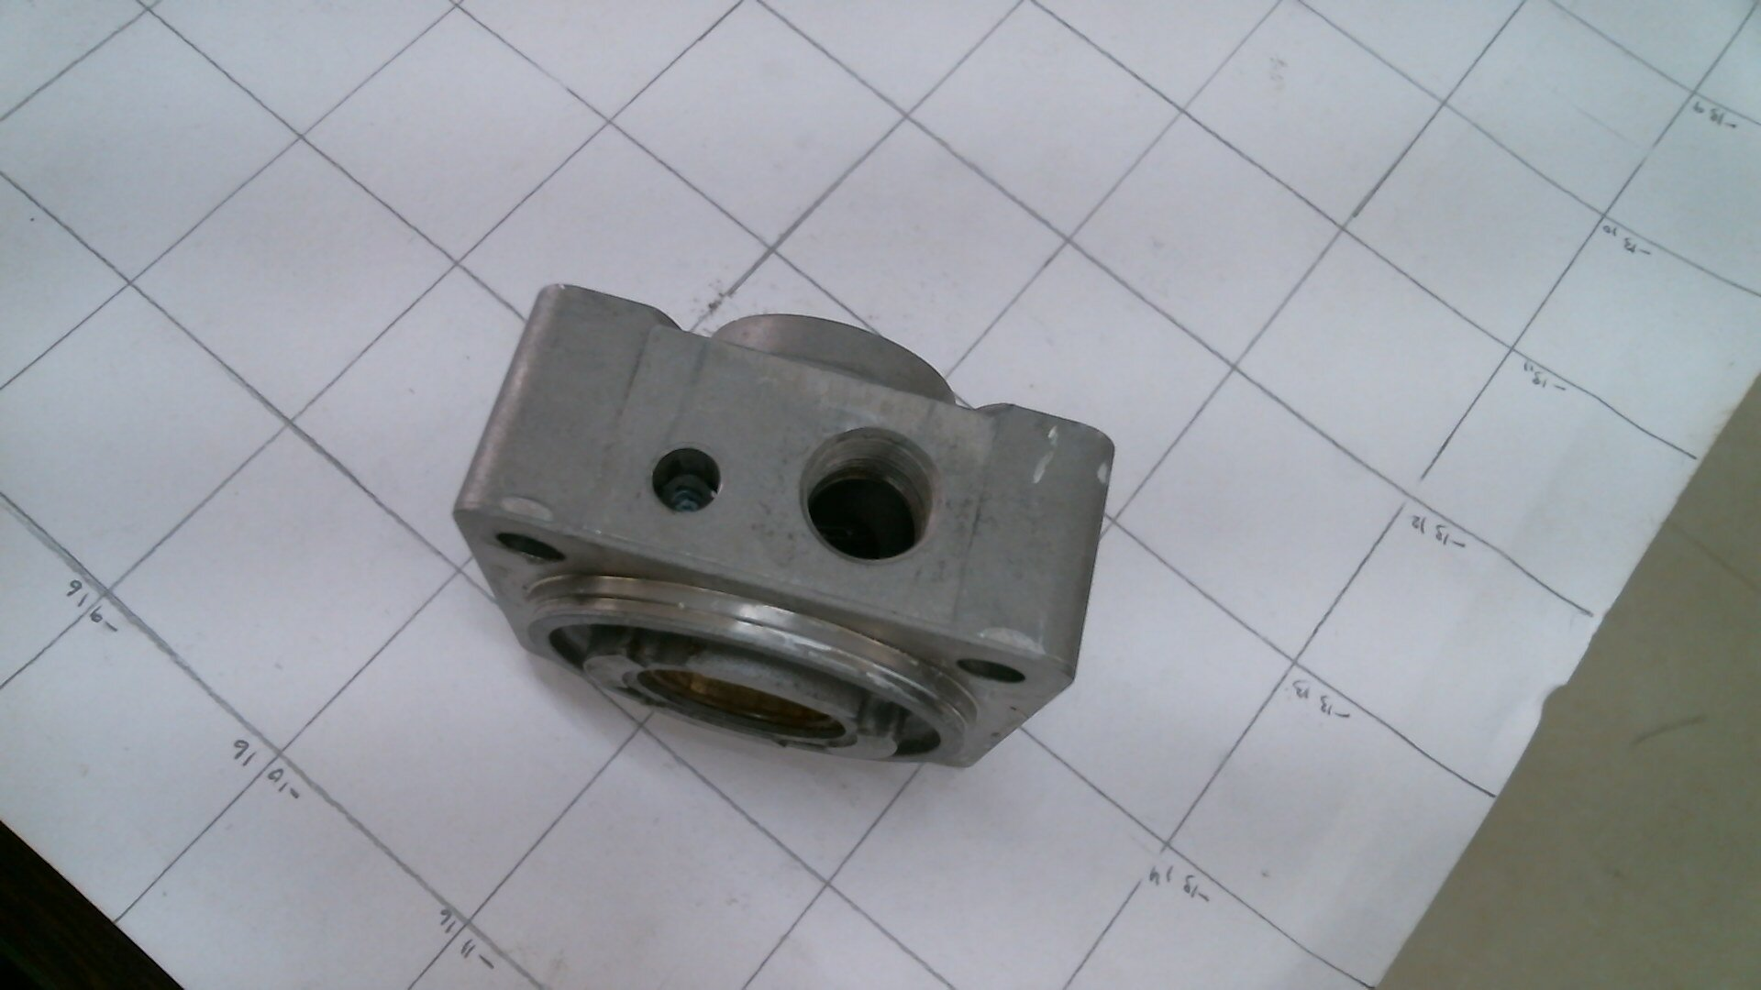
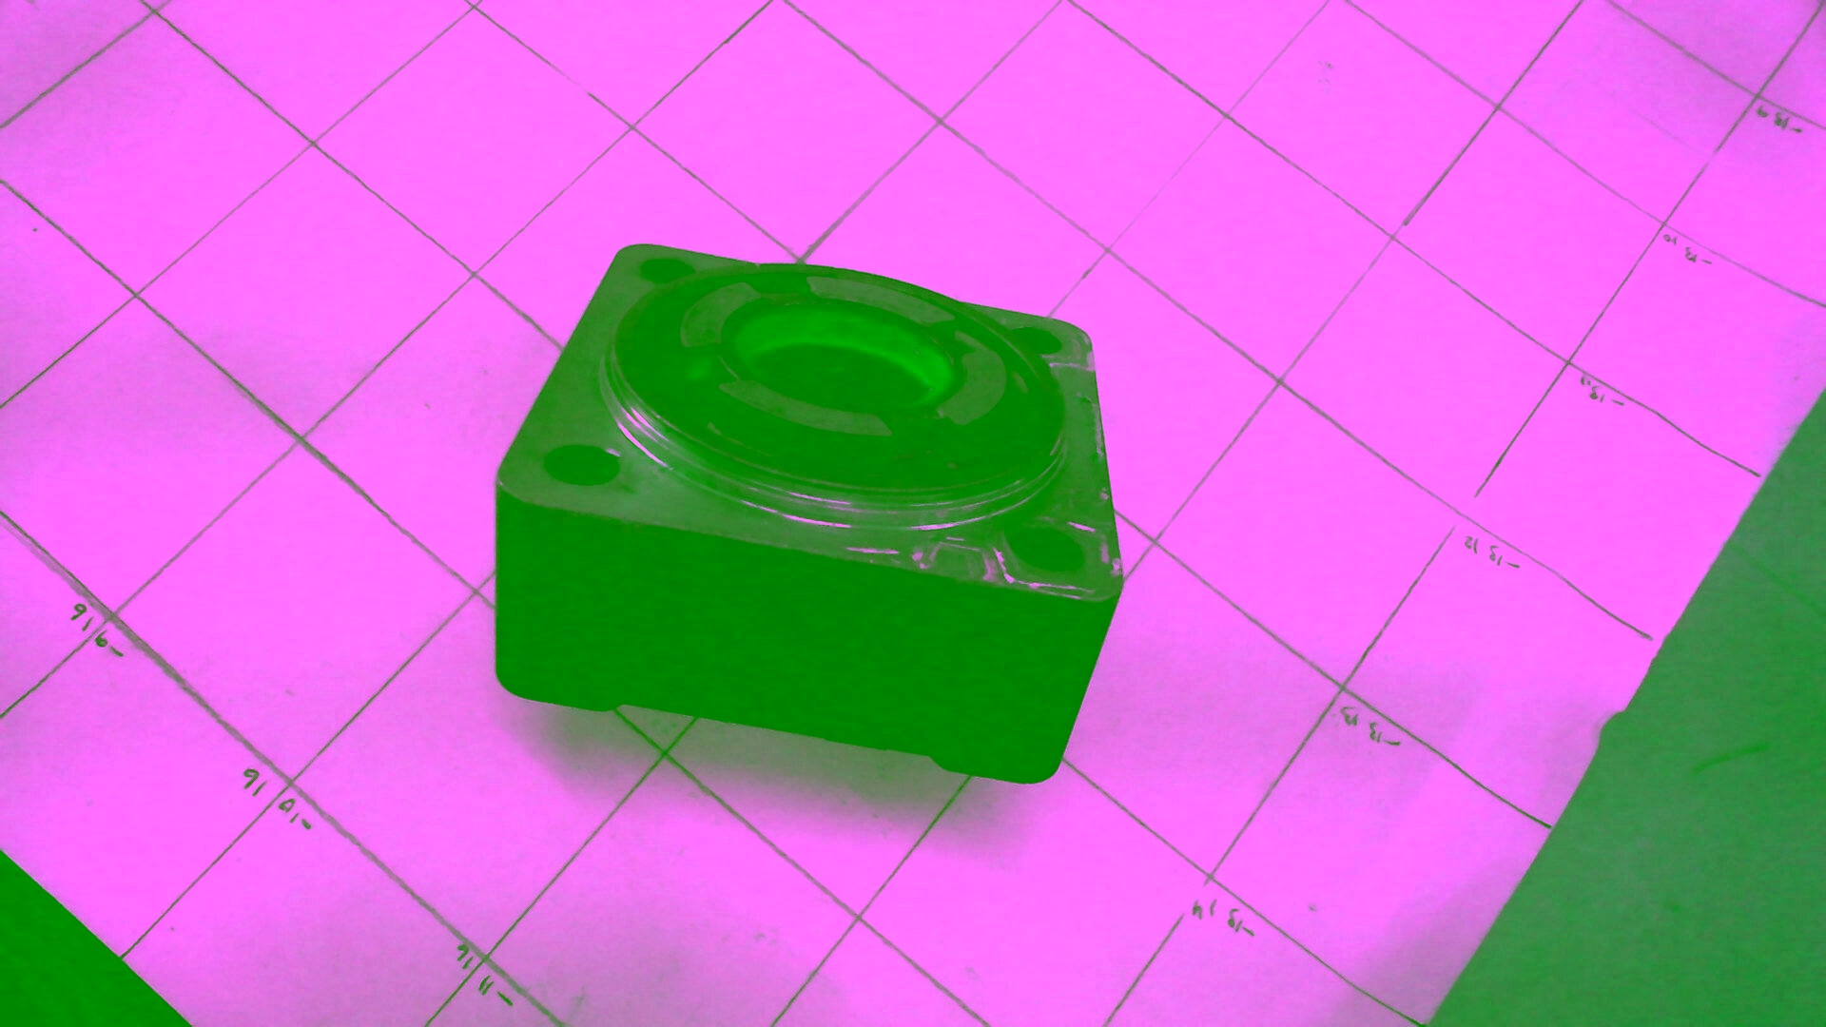
Training Dataset
3D Printed Specimen Replica (Class A) |  | Metal Specimen (Class B)

Slide 32
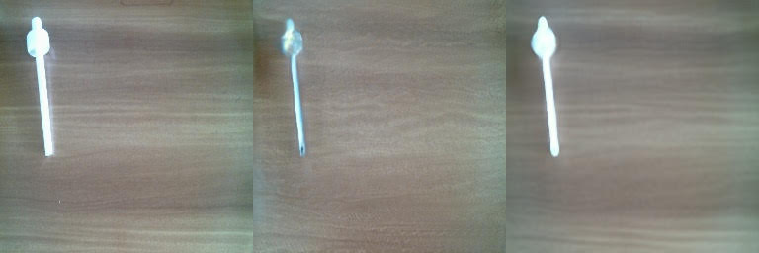
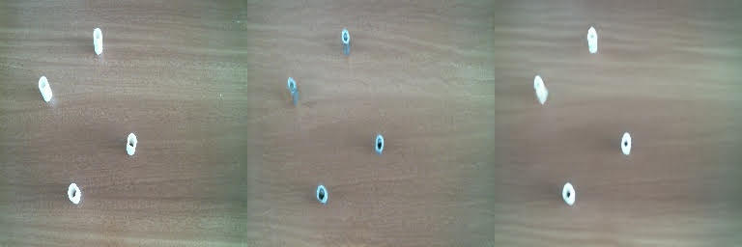
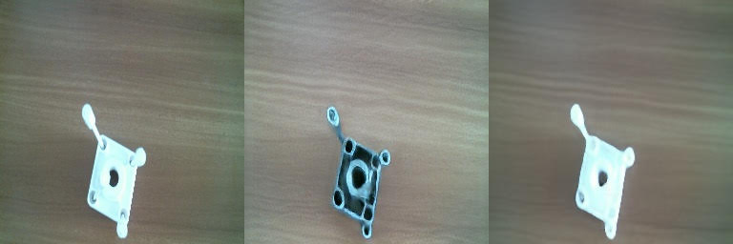
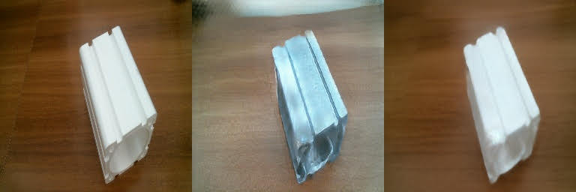

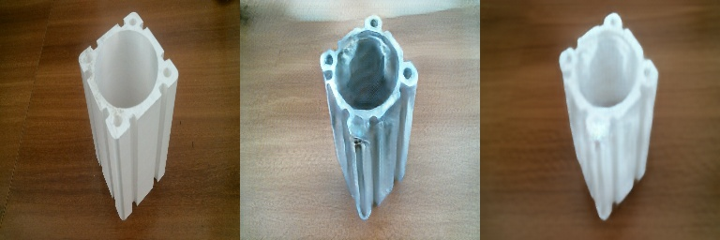
Results of CycleGAN
Class A to Class B (Success)
reference
generated

Slide 33
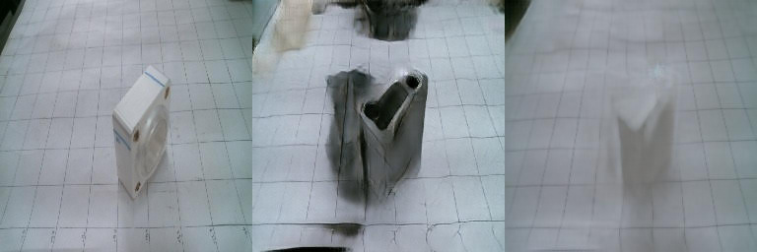

Results of CycleGAN
Class A to Class B (Failures)
The model seems to not work properly with white background where there is not sufficient contrast between the 3D specimen and the background (left) and in environments with high light intensities causing the objects to have a shiny surface while capturing images, due to which the model is not able replicate the expected texture and color for the generated object even though the generated shape matches (right).
reference
generated

Slide 34

Thank You.
By Gyanig Kumar
Research Assistant, I3D Lab, IISc

Slide 35
Generating Random Variables
Computers are fundamentally deterministic
it is possible to define algorithms that generate sequences of numbers whose properties are very close to the properties of theoretical random numbers sequences
Methods: inverse transform method, rejection sampling, Metropolis-Hasting algorithm and others
Notes:
Computers are fundamentally deterministic. So, it is, in theory, impossible to generate numbers that are really random (even if we could say that the question “what really is randomness ?” is a difficult one). However, it is possible to define algorithms that generate sequences of numbers whose properties are very close to the properties of theoretical random numbers sequences. In particular, a computer is able, using a pseudorandom number generator, to generate a sequence of numbers that approximatively follows a uniform random distribution between 0 and 1. The uniform case is a very simple one upon which more complex random variables can be built in different ways.

Slide 36
Generating Random Variables
Rejection sampling
Sampling from a well-known simple distribution
Accept or reject the sampled value depending on some condition
Repeating this process until the sampled value is accepted
Metropolis-Hasting algorithm
find a Markov Chain (MC) such that the stationary distribution of this MC corresponds to the distribution from which we would like to sample our random variable
Once this MC found, we can simulate a long enough trajectory over this MC to consider that we have reach a steady state

Slide 37

Generating Random Variables
inverse transform method
Let X be a complex random variable we want to sample from
U be a uniform random variable over [0,1] we know how to sample from
a random variable is fully defined by its Cumulative Distribution Function (CDF)
CDF of a random variable is a function from the domain of definition of the random variable to the interval [0,1]

Slide 38
Generating Random Variables
inverse transform method
way to generate a random variable that follows a given distribution by making a uniform random variable goes through a well designed “transform function” (inverse CDF)
Illustration of the inverse transform method. In blue: the uniform distribution over [0,1]. In orange: the standard gaussian distribution. In grey: the mapping from the uniform to the gaussian distribution (inverse CDF).

Slide 39
Generate very complex random variables
Problem of generating a new image of dog is equivalent to the problem of generating a new vector following the “dog probability distribution” over the N dimensional vector space. So we are, in fact, facing a problem of generating a random variable with respect to a specific probability distribution.
… so let’s use transform method with a neural network as function!
Notes:
Suppose that we are interested in generating black and white square images of dogs with a size of n by n pixels. We can reshape each data as a N=nxn dimensional vector (by stacking columns on top of each others) such that an image of dog can then be represented by a vector. However, it doesn’t mean that all vectors represent a dog once shaped back to a square! So, we can say that the N dimensional vectors that effectively give something that look like a dog are distributed according to a very specific probability distribution over the entire N dimensional vector space (some points of that space are very likely to represent dogs whereas it is highly unlikely for some others). In the same spirit, there exists, over this N dimensional vector space, probability distributions for images of cats, birds and so on.

Slide 40
Generative Matching Networks
Optimization needs two matching techniques
Direct
Indirect
Direct method
comparing the true and the generated probability distributions
Backpropagating the difference through the network
Indirect method
train the generative network by making these two distributions go through a downstream task
optimization process will enforce the generated distribution to be close to the true distribution
Notes:
Now, we still need to train (optimise) the network to express the right transform function. To this purpose, we can suggest two different training methods: a direct one and an indirect one.
The direct training method consists in comparing the true and the generated probability distributions and backpropagating the difference (the error) through the network. This is the idea that rules Generative Matching Networks (GMNs).
For the indirect training method, we do not directly compare the true and generated distributions. Instead, we train the generative network by making these two distributions go through a downstream task chosen such that the optimisation process of the generative network with respect to the downstream task will enforce the generated distribution to be close to the true distribution.
This last idea is the one behind Generative Adversarial Networks (GANs) that we will present in the next section. But for now, let’s start with the direct method and GMNs.

Slide 41
CycleGAN
an extension of Pix2Pix architecture which involves simultaneous training of two generator models and two discriminator models
Advantages over Pix2Pix
Disadvantages of Pix2Pix | Overcome by CycleGAN
Data required for training should be paired i.e., the images of source and target domain should be of same location Number of images of both the domains should also be same | training a deep convolutional neural network for image-to-image translation tasks mapping between input and output images using unpaired dataset
https://arxiv.org/abs/1703.10593

Slide 42
Pix2Pix
Based on conditional GAN (cGAN) architecture
Trained on paired set of images or scenes from two domains to be used for translation
Architecture consists of a Generator G and a Discriminator D
Generator G is an encoder-decoder net or U-Net with skip connection
Discriminator is a patch-GAN architecture, which penalizes at scale of patches
Cont..

Slide 43

Patch-GAN Discriminator
Works by classifying a patch of (n*n) in an image into real and fake
This forces more constraints and encourages sharp high frequency details
Discriminator accepts two image pairs as input, input image, target image and input image, generated image
loss consists of two losses; one is a sigmoid cross-entropy loss between real image and array of ones, and another is between generated image and array of zeros
Notes:
It works by classifying a patch of (n*n) in a image into real and fake rather than classifying whole image into real and fake. This forces more constraints and encourages sharp high frequency details. This works faster than classifing whole image and has less parameters. The discriminator accepts two image pairs as input, input image, target image and input image, generated image. we concatenate this two input pairs.
The discriminator loss consists of two losses, one is a sigmoid cross-entropy loss between real image and array of ones and another is between generated image and array of zeros. The total discriminator loss is sum of these two losses.

